Slide 1

Back to School Night
Veterans Elementary School
Notes:
[insert school name, principal name into slide]
Welcome
Introduce: principal, APs, etc.

Slide 2

VISION
Every student is
inspired to learn
and empowered
to excel
MISSION
We cultivate a vibrant
learning community that prepares students to thrive
in a dynamic world
www.hcpss.org/vision
Notes:
Howard County Public School System is entering the 4th year of a 5-year strategic plan: Vision 2018: Fulfilling the promise of preparation.
Vision 2018 is our roadmap toward becoming a world-class school system that fulfills the promise of preparation to every student. The promise of preparation means that every child develops the skills and knowledge they need to succeed in college, without the need for remedial courses, or in a high-wage career by the time they graduate high school.
Our school system vision: Every student is inspired to learn and empowered to excel.
Our mission: We cultivate a vibrant learning community that prepares students to thrive in a dynamic world.

Slide 3





School News and Information
Video
Email
In Person
Social Media
Print
Notes:
School Communications – OVERVIEW
Engaging parents and families as partners in education is a key priority of the HCPSS Strategic Plan, and is one of my/our school’s highest priorities. We use several communications tools to keep parents informed of what’s happening in the school and provide the information you need to make informed decisions regarding your child’s education. I’ll describe each of these in a moment [covered on following slides].
Often – personal communications are best.
Most important though, is that you feel comfortable reaching out to teachers and administrators whenever you have a concern or question. We’re happy to meet with parents, have you visit the classroom – call the school office with questions or to set up a convenient time. We also value parent involvement in school activities.
Feel free to contact any teacher or administrator via Email, or make an appointment to meet to discuss your concerns.

Slide 4
HCPSS News
Email
Text
School News
HCPSS News
Emergency Notices
Optional for
Emergency Notices
Only
Details: www.hcpss.org/hcpss-news/
Notes:
Parents receive news and announcements from our school and from the school system via the HCPSS News service.
Parents are automatically registered for this service. Email messages are delivered to the contact information that you provide in the Family File.
You will receive via email:
School newsletters & other communications
System-level announcements
Emergency notifications (school closings/delays).
Parents are given the option to receive text messages. New parents are sent a text message to opt-in for text alerts. – if you didn’t receive this, visit www.hcpss.org/hcpss-news/ to troubleshoot. Text alerts are sent to the mobile phone number identified in the Family File.
If you were already opted-in to receive text messages last year, and your phone number has not changed, you do not need to opt-in again.
Community members and others can sign up for this messaging service at www.hcpss.com/hcpss-news (or visit the home page www.hcpss.org)

Slide 5


School Closings/Delays
www.HCPSS.org
HCPSS News
@hcpss
HCPSS TV
HoCoSchools
Verizon 42
Comcast 72
Notes:
School Delays and Closings (usually weather-related) are communicated through several channels:
HCPSS homepage: www.hcpss.org - this is the first and most complete source of information
HCPSS News emails and texts
Social media: Twitter & Facebook
HCPSS TV – channel 42 (Verizon) and 72 (Comcast)

Slide 6
Veterans website
Announcements and news
School calendar
Staff directory
Academics
Student activities, sports, clubs
Links to HCPSS Connect and other resources
And more
veterans.hcpss.org
Notes:
[Fill in on slide: school name & web address initials]
Our school website is a one-stop destination where you can quickly find:
School calendar
Announcements and news
Academic departments
Student activities, sports, clubs
Staff directory and email links
Quick Links to HCPSS Connect, system website, and other resources
It provides mobile access and user-friendly navigation.

Slide 7


Social Media
[School name] Twitter: @hcpss_veterans
HCPSS Facebook: www.Facebook.com/HoCoSchools
HCPSS Twitter: www.Twitter.com/HCPSS
Interact with the Superintendent:
Twitter: www.Twitter.com/SuperHCPSS
Blog: superintendent.hcpss.org
Notes:
[insert school Twitter handle on slide if using; remove 1st line if not]
Link to our social media sites:
Get up-to-the-minute updates, news, student and school happenings, and announcements
Interact with the school and system

Slide 8


MOBILE APP
Notes:
The HCPSS Mobile App is available free to download for iphones, iPad, and Android devices in the app stores (search for “HCPSS”).
The app makes it quick and easy to find the information you need, when you need it. It provides:
Simplified access to information
On-the-go access and quick links
Compiles messages and calendar dates from multiple schools as well as district information, if you have children attending other schools as well.

Slide 9

SYNERGY STUDENT
INFORMATION
SYSTEM
CANVAS
LEARNING
SYSTEM
FAMILY FILE
www.hcpss.org/connect
Notes:
HCPSS Connect is the one-stop portal to access Synergy, Canvas, and the Family File.
The Synergy Student Information is the source for official student records & grades.
It gives teachers, administrators, and parents with the digital tools to easily access student information.
The Canvas Learning System gives teachers, parents, and students tools to communicate, collaborate, and connect.
Both systems are extremely easy to learn and to use.
Find full details and instructions online at www.hcpss.org/connect
Benefits of HCPSS Connect for Parents, Students & Teachers:
Improved & consistent user experience
Common digital platform for all schools & grades
Improved communication and collaboration
Anytime/anywhere across multiple devices
Single sign-on - 1 user/pass for HCPSS Connect

Slide 10

Parent contact information
Medical data and contacts
Afterschool transportation
Data privacy preferences
www.hcpss.org/connect
Notes:
The Family File on HCPSS Connect provides important information about your student. All information is confidential.
It is important that parents update the Family File with current data about your student including:
Parent emails and phone numbers
student medical contact data
afterschool transportation options
data privacy options
Log into HCPSS Connect and click the My Account tab. Save your changes by clicking the Update Account button.
Family File now remains open throughout the school year, so you can make changes at any time they occur.
Parents without online access can provide this information through a paper “Emergency Procedure and Confidential Student Information” form. Contact the school office for a copy of this form.

Slide 11


Getting Help
Login and Password assistance:
Contact School Office
Guides and Resources:
HCPSS Connect Homepage
Notes:
Parents will continue to use the same log in credentials as in prior years.
Parents of students new to HCPSS are mailed their login information (US Mail)
For help with your login or password: call the School Office
For help in using Canvas, Synergy, or the Family File, see the many guides and resources on the HCPSS Connect homepage (www.hcpss.org/connect)

Slide 12




By September 2016
Teacher Homepage
CANVAS
Digital Tools
Course information
Family communication
1st and 2nd Quarters
Calendar Dates/Events
3rd and 4th Quarters
Announcements
Notes:
CANVAS EXPECTATIONS for teachers the 2016-2017 school year:
This year all teachers will be posting information in the Canvas area in HCPSS Connect.
Targets for each quarter:
By September 2016
Teacher Homepage - Update and maintain teacher homepage
Navigation - Set the course navigation to hide and show appropriate Canvas items
Digital Tools - Include information regarding digital tools such as websites or applications that require an account on teacher homepage
Course information - Transfer or update content from previous year's course (s) into current year's course(s)
Family Communication - Share links or instructional tools with families
1st and 2nd Quarters
Calendar Dates - Share class/grade specific dates and events with families and students using the Canvas calendar.
3rd and 4th Quarters
Announcements - Communicate information with students and families using announcements at least once a quarter either through the teacher course or grade level course.

Slide 13

PARCC
Notes:
Partnership for Assessment of Readiness for College and Careers (PARCC) is the name for the standardized reading, writing and mathematics assessments implemented in all Maryland schools. PARCC assessments are directly aligned to the Common Core standards. PARCC replaced the Maryland School Assessment (MSA) for math and reading/English language arts and the High School Assessments in English 10 and Algebra I.
Changes to the PARCC Assessment:
Last year the PARCC consortium shortened the overall testing duration:
1. There is just one window for English Language Arts and Math—30 days in Spring.
2. The tests are shorter by about 90 minutes overall.
3. Students have 6-7 PARCC testing sessions (vs. 8 or 9 during the 1st year PARCC was implemented).
PARCC benefits:
Indicates how closely students, beginning in Grade 3, are on track to graduate college- and career-ready.
Gives teachers regular results to guide learning and instruction.
Provides data comparable across districts and states.
Scoring:
The PARCC assessments are on a 5 point scale. 1-Did not yet meet expectations, 2-Partially met expectations, 3-Approached expectations, 4-Met Expectations, and 5-Exceeded expectations:
In grades 3-8, ratings of 4-5 indicate students are academically well-prepared to engage successfully in further study.
In high school courses, a 4-5 indicates students are are on track to graduate prepared for colleges and careers and in future years will be used by in state community colleges for placement in credit bearing courses.
Students hand-carry results home in the first few weeks of the following school year.

Slide 14

Measures of Academic Progress (MAP)
Notes:
MAP (or Measures of Academic Progress) is an online test used in Grades 1-8
MAP allows us to assess where a student is performing, and how they’ve grown in achievement, several times each year. All Elementary and Middle schools will participate in MAP.
MAP gives teachers timely feedback on student progress throughout the school year that they can use this information to adjust instruction effectively.
MAP provides many advantages:
It assesses proficiency in Math and Language usage in addition to Reading.
It is computer-adaptive – i.e. the questions adapt in real-time to the student’s proficiency level. This appeals to students, because it isn’t a typical “mastery” test.
It is implemented several times during the year and provides quick, actionable feedback to teachers
It is directly aligned to Common Core standards.
It provides information on a student’s year to year growth.
It takes less time than the previous HCPSS quarterly assessments.
Students hand-carry results home a few weeks after the testing window ends.
INSERT TEST DATES

Slide 15

CogAT (Cognitive Abilities Test) - Grades 3-5
Measures verbal, quantitative, and learned reasoning abilities
Used for GT placement decisions
Notes:
CogAT – Grades 3-5
CogAT (Cognitive Abilities Test) is used to make student placement decisions for G/T programs. CogAT measures students’ verbal, quantitative and nonverbal reasoning abilities: the three areas most closely related to success in school.
We know that students who participate in our Gifted and Talented program are well-prepared for the rigorous opportunities that come later in high school and college. Our goal is to widen access to enriching learning opportunities for all students. CogAT is only one of many pieces of data that are looked by a school based committee to make placement decisions.
The CoGAT provides a wealth of data that is not measured by other tests. This data is very useful in identifying students who would benefit from GT coursework, and is valuable to teachers of all students in tailoring instruction to meet student needs:
CogAT measures learned reasoning abilities. These include abilities developed through both in-school or out-of-school experiences. Each of the three subtest areas make use of multiple test formats. This increases both the fairness and the validity of the scores.
The Verbal portion of the test measures flexibility, fluency, and adaptability in reasoning and solving verbal problems. These play an important role in reading comprehension, critical thinking, writing, and virtually all verbal learning tasks.
The Quantitative portion measures quantitative reasoning skills that are significantly related to problem solving in mathematics and other disciplines.
The Nonverbal portion measures a student’s ability to invent and implement strategies for solving novel problems.
Results are mailed home with placement recommendations in the Spring.

Slide 16

NGSS Science Curriculum
NGSS Integrates:
Scientific and engineering practices
Crosscutting concepts across scientific disciplines
Core ideas in science
More information: nextgenscience.org
Notes:
The K-12 science curriculum is aligned to the Next Generation Science Standards (NGSS), which were jointly developed by professional scientists and educators. Maryland adopted the Next Generation Science standards as the Maryland Science Standards in 2013.
The NGSS combine and emphasize scientific and engineering practices, crosscutting concepts, and core ideas in science that all K-12 students should master in order to prepare for success in college and 21st century careers.
The HCPSS science curriculum integrates science and engineering practices with important disciplinary ideas from the three major scientific disciplines: earth/space science, life science (biology), and physical science (chemistry and physics)
The science curriculum is designed to prepare students with sufficient core knowledge so they can later acquire additional information on their own, because science knowledge is continually expanding.
Our goal is to develop science literacy and a solid foundation for success in higher education and careers in science or engineering.

Slide 17
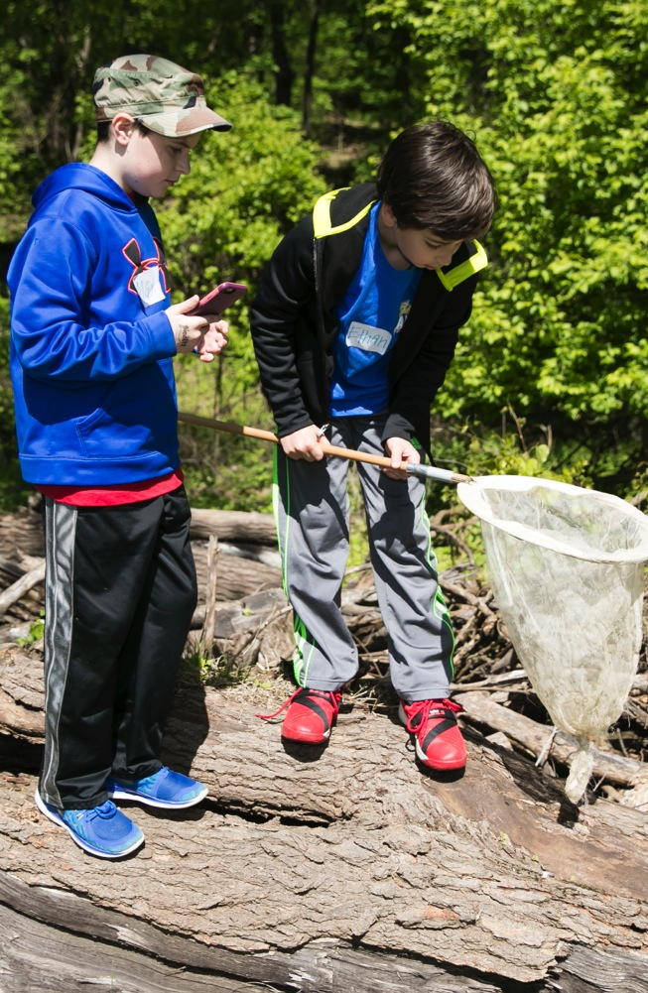
Science in Grades K-5
Each quarter of science instruction includes a unit based upon one or more core ideas in:
Earth/Space science
Life science (biology)
Physical science (chemistry and physics)
Notes:
The HCPSS science curriculum integrates science and engineering practices with important disciplinary ideas from the three major scientific disciplines: earth/space science, life science (biology), and physical science (chemistry and physics).
Students have science instruction each quarter. The units are designed to integrate the Three Dimensions of NGSS. They focus on an overarching question, relate to real life, and typically involve applying the science learned to solve an engineering problem.

Slide 18

Maryland Integrated Science Assessment (MISA)
Notes:
MISA (Maryland Integrated Science Assessment) is the new standardized science assessment aligned to the NGSS. MISA will cover all science disciplines: Earth/Space science, Life Science, Physical Science, and Engineering. MISA will take the place of MSA Science.
Our goal is to teach to help students be scientifically literate, rather than teaching to pass a standardized test. Thus, MISA is not aligned to any unit of study or specific content to memorize.
MISA, for elementary students, will take place this school 2016-17. Revisions to the elementary science curriculum have been underway for the last three years, to ensure that students taking the MISA in fifth grade, have been taught using the Three Dimensions of NGSS since third grade.
HCPSS will share details about the new NGSS-aligned science curriculum and MISA testing over the following months.

Slide 19

School-Family Partnership
Notes:
Parents and families play an important role in strengths development.
Parents of 4th and 5th graders will be informed of their child’s top 3 strengths, and will receive a Parent Toolbook and other resources that can help you talk with and reinforce these concepts at home.
You can expect a discussion around your child’s strengths during parent-teacher conferences.

Slide 20

Interactive School Menus App
Food descriptions
Nutrition and allergens
Carb counts
Pre-payment links
Menus
Breakfast and lunch
hcpss.nutraslice.com
Notes:
HCPSS now offers online school menus through a website and mobile app by Nutrislice.
The interactive menus are designed to be more convenient and informative, providing access to up-to-the-minute updated content anytime, anywhere.
The innovative school menu site features nutrition and allergen information for all Howard County school meal items, both breakfast and lunch, and includes:
carb counts
allergen filters
food descriptions and photos
menu item rating system
links to MySchoolBucks pre-payment options
monthly menu email subscription sign-up
and more
Menus are available in four languages.
Options for using the interactive menus:
Online: hcpss.nutraslice.com
Download the free app, “School Lunch by Nutrislice,” in the Google Play or App stores.

Slide 21
Responsible Use of Technology and Social Media
Notes:
Communications technology, including social media, is a fact of modern life. Learning to use technology effectively and responsibly is an important part of every student’s education.
HCPSS has launched a year-long community campaign to encourage responsible use of technology and social media. Look for posters like this, and other announcements and upcoming events for students and families to explore this important topic. Follow our progress online at #lastingimpressions.
Use of Personal Devices in School:
Elementary students may have personal communication devices in their backpacks during the school day. Devices must be TURNED OFF during school hours.
Elementary students may use devices before or after school hours, or in the front office or classroom with the permission of the teacher/administrator.
To clarify a common misperception:
BYOD (Bring Your Own Device) refers to the optional use by secondary students of personal devices (phones or tablets) for teacher-sanctioned instructional activities. There are NO PLANS to introduce BYOD at the elementary level.
More information is available online at www.hcpss.org/byod

Slide 22

Sunday, October 16
REGISTER NOW!
www.hcpss5k.com
Notes:
Each year HCPSS holds the Let’s Go HoCo 5K Race and family1-mile fun run. This year’s race promises to be even bigger and better.
The race will be held Sunday morning, October 16th on Columbia Gateway Drive (new location this year).
Registration is now open at www.hcpss5k.com.
Mark this date on your calendar and encourage your staff and your school families to participate.
The Race supports our system’s continued commitment to wellness – for healthy staff, healthy families and healthy kids.

Slide 23

Celebrating HCPSS Students, Staff, and Schools
Bimonthly magazine
Print and online
Student achievements
Dedicated staff
School activities
celebrate.hcpss.org
Notes:
Celebrate HCPSS is our new school system magazine. It offers interesting, colorful features about some of the most exciting school projects, inspiring people, and promising programs in HCPSS.
You’ll see print issues in our school lobby and in locations around the county. An online version is also available at celebrate.hcpss.org, which offers extra photos and additional information.
Let us know about the topics you’d like to see in Celebrate HCPSS!

Slide 24
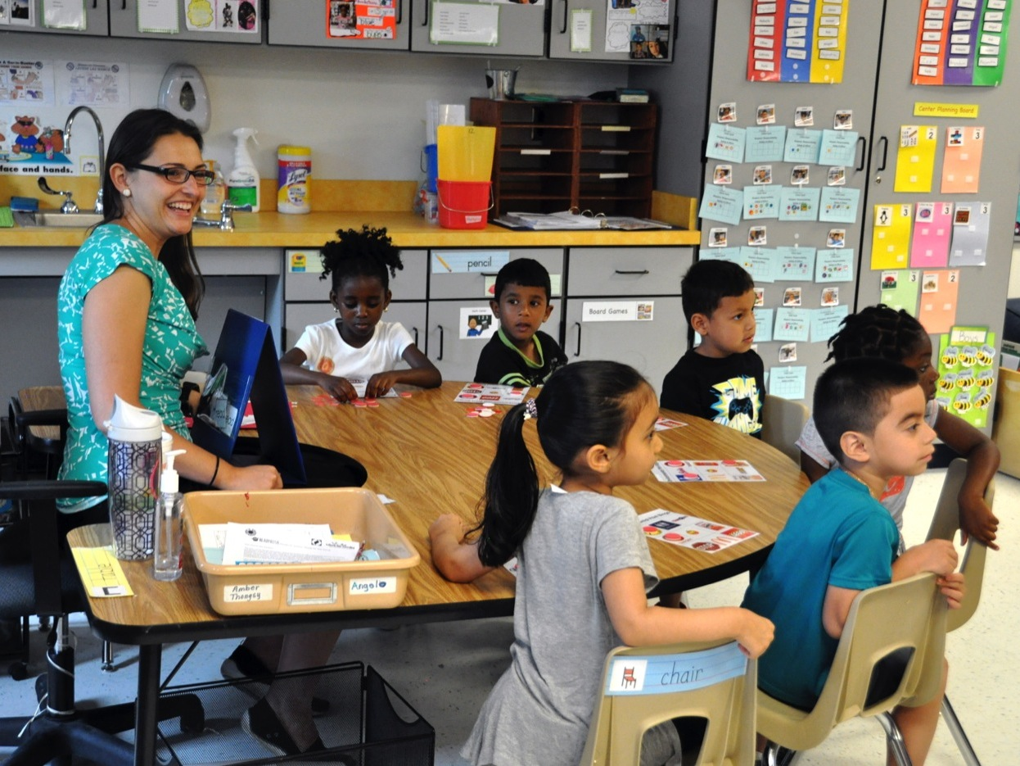
What Your Child Will Learn Guides
CANVAS
Notes:
What Your Child Will Learn guides provide an overview of the instructional program for your child’s grade, as well as student goals and expectations. The guides include information to help parents monitor and support their child’s progress during the school year.
Individual guides are provided for each grade level. Each grade level guide provides information categorized by curriculum area, e.g., Language Arts, Science, etc.
Find the guides online in Canvas.
The guides are available online only; print versions are no longer distributed. Specific sections may be printed from Canvas.
The guides provide general information about content covered in each curriculum area. Specific student programs may differ, depending on instructional needs.

Slide 25
Child Abuse & Neglect Policy and Confidentiality Training
Powerpoints are available on our website ves.hcpss.org.
Look for Get Involved Tab, view the powerpoints, print out certificates and send to your child’s teacher.

Slide 26
Reminders…..
1. Please remember to sign in and out in the office when coming to school. Visitor Management System.
2. Please remember to contact teacher 24 hrs in advance to make arrangements to visit your child’s classroom. Teacher will inform us of your scheduled visit.
3. All visitors must wear a visitor’s sticker.
4. Remember to have photo identification ready for viewing if you would like to sign your child out or you have arranged a visit.
5. Children come to school to learn. It is that healthy Respect for Learning that we want to cultivate. Student Handbook has our discipline policy in it. We appreciate your support of the school in regard to discipline.

Slide 27
More reminders
6. Please remember that weapons of any kind are not allowed in school. Anything used as a weapon is a violation of this policy.
7. Dress Code- Please remember how your child is dressed sends a message. We prohibit advertisements that are not appropriate to children. Shorts that are too short are also prohibited. Flip flops are unsafe.
8. Parent Pick up and Drop off Lane.
9. Please do not arrive at Bus Dismissal and ask to get your child off the bus.

Slide 28

Have a Great Year !

